Slide 1
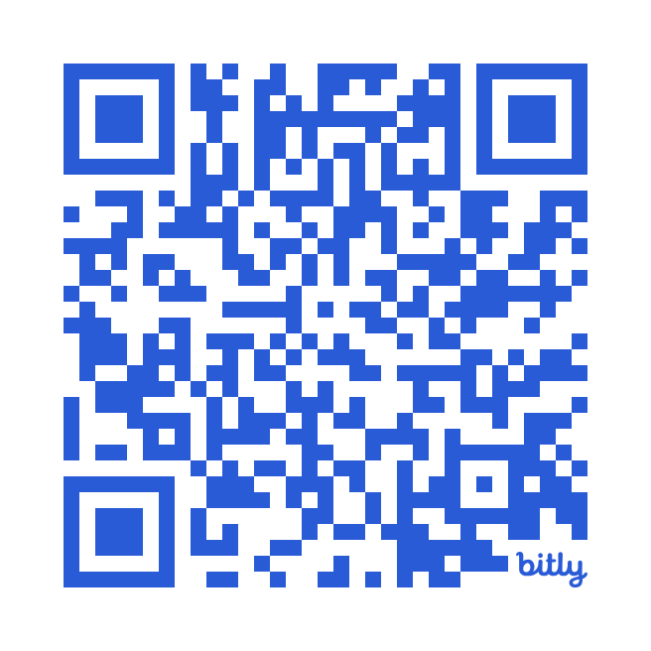
Statistical Tools for Educational Research on Knowledge Acquisition
https://bit.ly/stats_Fisica
Peter A. Edelsbrunner 10 June 2025 1st PhysEd Afternoon StatsBreak
Notes:
Don’t put statistics in the end
Don’t trust a single statistician
Don’t rely on p-values
Statistics matters after data collection -> From the beginning of study planning
Median split
Confirmatory vs. exploratory analyses
https://www.autodeskresearch.com/publications/samestats

Slide 2
A typical study on conceptual change:
(Quasi-) Experimental Pre – Post – (Follow-up -) Intervention – Control Design
Experimental intervention
time
Pretest
Posttest
Follow-up test
……..
Control intervention
time
Pretest
Posttest
Follow-up test
……..
Notes:
Design für Workshop

Slide 3
Do students in the experimental condition gain knowledge?
Do students in the experimental condition gain more knowledge than students in the control condition?
Experimental condition
Pretest
Posttest
Control condition
Pretest
Posttest
Notes:
Design für Workshop

Slide 4

Statistics comes after data collection
30 participants per condition are great
p-values indicate whether our Hypotheses are correct
Participants with missing data should not be analyzed
Asking a statistician ensures everything’s right
There is one statistical model for each study design
Notes:
I) Uncertainty -> plan your sample size
II) Visual inspection -> Look into your data
III) Missing data -> Don’t throw them away
IV) Significance testing (p-values) -> Beware
IV) Model choice -> Answer your question
I) Uncertainty -> plan your sample size
II) Visual inspection -> Look into your data
III) Missing data -> Don’t throw them away
IV) Significance testing (p-values) -> Beware
V) Model choice -> Answer your question
VI) Statistics comes in the end -> Beginning
VII) Statisticians know what they are talking about -> Don’t believe a single one, believe many

Slide 5
Statistics comes after data collection “Now I have my data, let’s look for a model and analyze!”
30 participants per condition are great
p-values indicate whether our Hypotheses are correct
Participants with missing data should not be analyzed
Asking a statistician ensures everything’s right
There is one statistical model for each study design
Notes:
I) Uncertainty -> plan your sample size
II) Visual inspection -> Look into your data
III) Missing data -> Don’t throw them away
IV) Significance testing (p-values) -> Beware
IV) Model choice -> Answer your question
I) Uncertainty -> plan your sample size
II) Visual inspection -> Look into your data
III) Missing data -> Don’t throw them away
IV) Significance testing (p-values) -> Beware
V) Model choice -> Answer your question
VI) Statistics comes in the end -> Beginning
VII) Statisticians know what they are talking about -> Don’t believe a single one, believe many

Slide 6
Statistics comes after data collection
30 participants per condition are great “Let’s aim at 20-30 people in each group, that will be fine!”
p-values indicate whether our Hypotheses are correct
Participants with missing data should not be analyzed
Asking a statistician ensures everything’s right
There is one statistical model for each study design
Notes:
I) Uncertainty -> plan your sample size
II) Visual inspection -> Look into your data
III) Missing data -> Don’t throw them away
IV) Significance testing (p-values) -> Beware
IV) Model choice -> Answer your question
I) Uncertainty -> plan your sample size
II) Visual inspection -> Look into your data
III) Missing data -> Don’t throw them away
IV) Significance testing (p-values) -> Beware
V) Model choice -> Answer your question
VI) Statistics comes in the end -> Beginning
VII) Statisticians know what they are talking about -> Don’t believe a single one, believe many

Slide 7
Statistics comes after data collection
30 participants per condition are great
p-values indicate whether our Hypotheses are correct “A significant p-value – my study was successful!”
Participants with missing data should not be analyzed
Asking a statistician ensures everything’s right
There is one statistical model for each study design
Notes:
I) Uncertainty -> plan your sample size
II) Visual inspection -> Look into your data
III) Missing data -> Don’t throw them away
IV) Significance testing (p-values) -> Beware
IV) Model choice -> Answer your question
I) Uncertainty -> plan your sample size
II) Visual inspection -> Look into your data
III) Missing data -> Don’t throw them away
IV) Significance testing (p-values) -> Beware
V) Model choice -> Answer your question
VI) Statistics comes in the end -> Beginning
VII) Statisticians know what they are talking about -> Don’t believe a single one, believe many

Slide 8
Statistics comes after data collection
30 participants per condition are great
p-values indicate whether our Hypotheses are correct
Participants with missing data should not be analyzed “This one missed an assessment, let’s drop him/her from the datafile!”
Asking a statistician ensures everything’s right
There is one statistical model for each study design
Notes:
I) Uncertainty -> plan your sample size
II) Visual inspection -> Look into your data
III) Missing data -> Don’t throw them away
IV) Significance testing (p-values) -> Beware
IV) Model choice -> Answer your question
I) Uncertainty -> plan your sample size
II) Visual inspection -> Look into your data
III) Missing data -> Don’t throw them away
IV) Significance testing (p-values) -> Beware
V) Model choice -> Answer your question
VI) Statistics comes in the end -> Beginning
VII) Statisticians know what they are talking about -> Don’t believe a single one, believe many

Slide 9
Statistics comes after data collection
30 participants per condition are great
p-values indicate whether our Hypotheses are correct
Participants with missing data should not be analyzed
Asking a statistician ensures everything’s right “Perhaps, I should ask someone with more experience how to analyze my data!”
There is one statistical model for each study design
Notes:
I) Uncertainty -> plan your sample size
II) Visual inspection -> Look into your data
III) Missing data -> Don’t throw them away
IV) Significance testing (p-values) -> Beware
IV) Model choice -> Answer your question
I) Uncertainty -> plan your sample size
II) Visual inspection -> Look into your data
III) Missing data -> Don’t throw them away
IV) Significance testing (p-values) -> Beware
V) Model choice -> Answer your question
VI) Statistics comes in the end -> Beginning
VII) Statisticians know what they are talking about -> Don’t believe a single one, believe many

Slide 10
Statistics comes after data collection
30 participants per condition are great
p-values indicate whether our Hypotheses are correct
Participants with missing data should not be analyzed
Asking a statistician ensures everything’s right
There is one statistical model for each study design “A repeated measures ANOVA is the gold standard!”
Notes:
I) Uncertainty -> plan your sample size
II) Visual inspection -> Look into your data
III) Missing data -> Don’t throw them away
IV) Significance testing (p-values) -> Beware
IV) Model choice -> Answer your question
I) Uncertainty -> plan your sample size
II) Visual inspection -> Look into your data
III) Missing data -> Don’t throw them away
IV) Significance testing (p-values) -> Beware
V) Model choice -> Answer your question
VI) Statistics comes in the end -> Beginning
VII) Statisticians know what they are talking about -> Don’t believe a single one, believe many

Slide 11
Statistics comes after data collection
30 participants per condition are great
p-values indicate whether our Hypotheses are correct
Participants with missing data should not be analyzed
Asking a statistician ensures everything’s right
There is one statistical model for each study design
Notes:
Take one of these that you find find most instriguing and do the following:
Reflect on the statement and note down your own thoughts and perspective on it: Do you agree with the statement?
If yes, why, if no, why not?

Slide 12
Statistics comes after data collection “Now I have my data, let’s look for a model and analyze!”
30 participants per condition are great
p-values indicate whether our Hypotheses are correct
Participants with missing data should not be analyzed
Asking a statistician ensures everything’s right
There is one statistical model for each study design
Notes:
I) Uncertainty -> plan your sample size
II) Visual inspection -> Look into your data
III) Missing data -> Don’t throw them away
IV) Significance testing (p-values) -> Beware
IV) Model choice -> Answer your question
I) Uncertainty -> plan your sample size
II) Visual inspection -> Look into your data
III) Missing data -> Don’t throw them away
IV) Significance testing (p-values) -> Beware
V) Model choice -> Answer your question
VI) Statistics comes in the end -> Beginning
VII) Statisticians know what they are talking about -> Don’t believe a single one, believe many

Slide 13
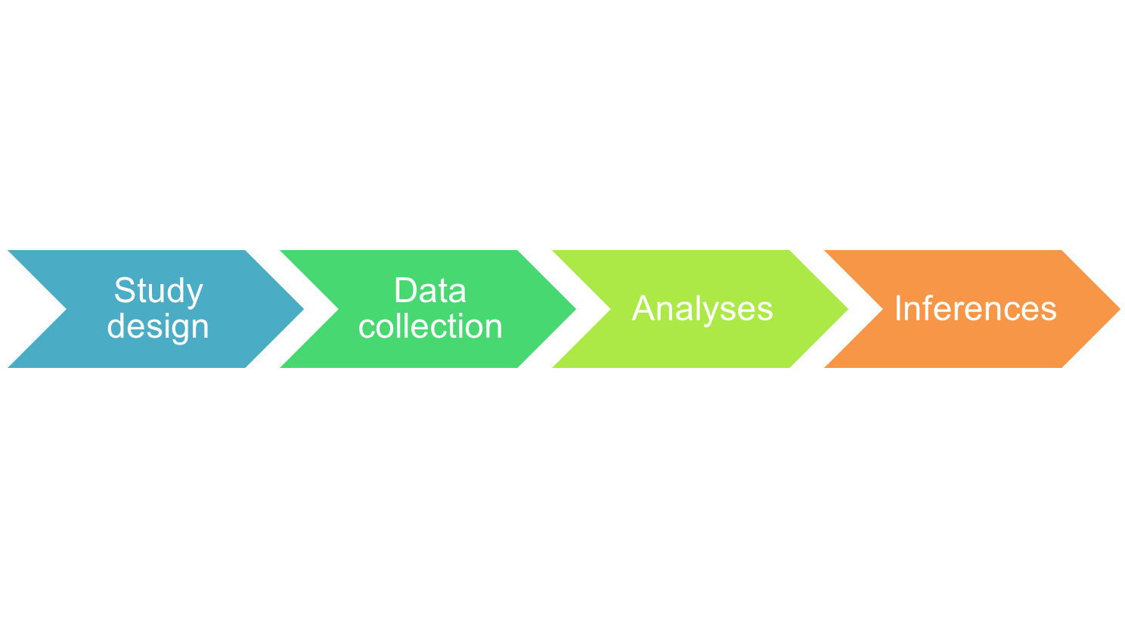
Statistics
Notes:
Statistics is usually seen as something that comes in the end, when all the “hard work” has been data and data have been collected.
This is, however, a mistake.
Statistics has to be an integral part of the study design phase; otherwise, in the end, we will not have the information that we were aiming at.
Let me give you some examples:

Slide 14
«I would like to know the influence of the learning task-context on students’ achievement»
You should have had at least 3-4 different learning tasks (-> latent variable model)
«It seems that my measures were not very reliable»
You should have used at least 3-4 items for everything you assessed (-> latent variable model)
«I would like to know whether the teachers’ content knowledge affected students’ learning»
You should have had at least 30 different teachers in the study (-> multilevel model)
«I would like to estimate students’ learning curves throughout the intervention»
You should have had at least 3-4 assessment points (-> growth curve model)
«I could not assign teachers (or learners) randomly to the different conditions – still, I would like to know whether the conditions had different effects»
You should have assessed teacher/learner background variables (-> propensity score matching)
«I would like to know whether students’ reading comprehension influenced the intervention effect»
You should have had more difficult transfer items after the intervention (-> ceiling effects)
«We have carefully coded videographed data of the teachers, but we cannot find effects»
You should have had at least 30 teachers in each study condition (-> power issue)
Notes:
PhD students often come to me with their datasets from their finished studies. They have finished 6 months of data collection and now they are really proud of their achievement. They tell me about their study design, and then what they would like to know about the data. Often, it turns out that the study design and data assessment procedures do not match with the questions that the PhD researchers have. Some examples:

Slide 15
Study design
Data collection
Analyses
Inferences
x
Statistics

Slide 16
Study design
Data collection
Analyses
Inferences
✓
Statistics
Stats is part of design, piloting, and it affects inferences
Notes:
Nur am Ende des Studienprozesses? – nein, tatsächlich von der anfänglichen Studienplanung, über die Datenerhebung, Auswertung und Interpretation interagiert Statistik mit allen Entscheidungen, die wir treffen.

Slide 17
Statistics comes after data collection “Now I have my data, let’s look for a model and analyze!”
30 participants per condition are great
p-values indicate whether our Hypotheses are correct
Participants with missing data should not be analyzed
Asking a statistician ensures everything’s right
There is one statistical model for each study design
Notes:
I) Uncertainty -> plan your sample size
II) Visual inspection -> Look into your data
III) Missing data -> Don’t throw them away
IV) Significance testing (p-values) -> Beware
IV) Model choice -> Answer your question
I) Uncertainty -> plan your sample size
II) Visual inspection -> Look into your data
III) Missing data -> Don’t throw them away
IV) Significance testing (p-values) -> Beware
V) Model choice -> Answer your question
VI) Statistics comes in the end -> Beginning
VII) Statisticians know what they are talking about -> Don’t believe a single one, believe many

Slide 18
Statistics comes before data collection “Now I have a good research question, let’s think through the study design and analyses!”
30 participants per condition are great
p-values indicate whether our Hypotheses are correct
Participants with missing data should not be analyzed
Asking a statistician ensures everything’s right
There is one statistical model for each study design
Notes:
I) Uncertainty -> plan your sample size
II) Visual inspection -> Look into your data
III) Missing data -> Don’t throw them away
IV) Significance testing (p-values) -> Beware
IV) Model choice -> Answer your question
I) Uncertainty -> plan your sample size
II) Visual inspection -> Look into your data
III) Missing data -> Don’t throw them away
IV) Significance testing (p-values) -> Beware
V) Model choice -> Answer your question
VI) Statistics comes in the end -> Beginning
VII) Statisticians know what they are talking about -> Don’t believe a single one, believe many

Slide 19
Statistics comes before data collection
30 participants per condition are great “Let’s aim at 20-30 people in each group, that will be fine!”
p-values indicate whether our Hypotheses are correct
Participants with missing data should not be analyzed
Asking a statistician ensures everything’s right
There is one statistical model for each study design
Notes:
I) Uncertainty -> plan your sample size
II) Visual inspection -> Look into your data
III) Missing data -> Don’t throw them away
IV) Significance testing (p-values) -> Beware
IV) Model choice -> Answer your question
I) Uncertainty -> plan your sample size
II) Visual inspection -> Look into your data
III) Missing data -> Don’t throw them away
IV) Significance testing (p-values) -> Beware
V) Model choice -> Answer your question
VI) Statistics comes in the end -> Beginning
VII) Statisticians know what they are talking about -> Don’t believe a single one, believe many

Slide 20
Why sample size is important
There is variation between samples – is there a robust trend of learning?
Statistical significance test
2. Sample (60 students):
M = 2.05, SD = 2.05
3. Sample (60 students):
M = -.12, SD = 1.83
1. Sample (60 students):
M = 1.02, SD = 1.71
Learning gains
+3
+4
-5
0
+5
+1
-1
+2
-4
-2
-3
Notes:
To understand why it is important to consider sample size in detail, before we conduct a study, assume we conduct the study on floating and sinking a second time. Now, we find a different average learning gain of just 0.71 points. This is logical, because we have a new group of students and these will learn differently than the first group. Then, we conduct the study a third time and now we even find a little bit of decrease in their knowledge.
The problem that we have now is that we usually conduct a study onle once. So, if we observe a learning gain of 1 points in our study, it could be the case that our intervention does not work reliably, so this average learning gain was just due to chance.
This makes it difficult for us to draw strong conclusions:
If we find a learning gain in our sample, is this just because is was a good sample, or is there really a reliable trend that the intervention works?
In order to find this out, we use statistical significance tests. We will discuss these tests in a minute. For now, it is important to know that a statistical significance test should indicate whether we can be reasonably sure that there is a trend that the intervention works.

Slide 21
Why sample size is important
We aim at high reliability (> 80%) of our statistical tests
Depends on effect size and sample size
Bigger effect -> smaller sample necessary
Smaller effect -> larger sample necessary
Statistical significance test
2. Sample (60 students):
M = 2.05, SD = 2.05
3. Sample (60 students):
M = -.12, SD = 1.83
1. Sample (60 students):
M = 1.02, SD = 1.71
Learning gains
+3
+4
-5
0
+5
+1
-1
+2
-4
-2
-3
Notes:
We want a high probability (> 80%) that our statistical test will reliably show us whether there is an effect, or not
The bigger my sample is, the less the estimated value will differ between samples – if the sample is bigger, it happens much more often that we can be sure that our intervention works (or not).

Slide 22
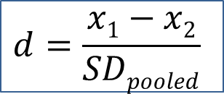
Effect size value
Cohen’s d (0-inf)
Difference in
Standard deviations
$$d=\frac{x1−x2}{SDpooled}$$
Most common effect size
Typical values:
Well-designed interventions achieve learning gains of d = 0.60
Typical difference between intervention group and control group in the lab: about d = 0.40
In the field: d = 0.20
Standardized measures: d < 0.10

Slide 23
Power analysis
Which sample sizes do we need to reliably find effects of this size?
G*Power Software package:
Free, download from http://www.gpower.hhu.de/
Typical values:
Good lab intervention achieves learning gains of d = 0.6
24 students in order to reliably find learning gains
p-values app: peter1328.shinyapps.io/pvalues/

Slide 24
Power analysis
Which sample sizes do we need to reliably find effects of this size?
G*Power Software package:
Free, download from http://www.gpower.hhu.de/
Typical values:
Typical difference between intervention group and control group:
about 0.40
100 students per group (overall sample of 200 students)
Less is necessary in pre-post designs: about 60 students per group
If d is just 0.20: about 400 students per group!

Slide 25
Conclusion
With 20 participants in each group…
…no reliable answers to hypotheses will be possible
With 40-60 participants in each group…
…you can be quite sure in the end whether there was an intervention effect, or not
With 100-300 participants in each group…
…you will end up in analytic wonderland
…detailed and reliable hypotheses tests will be possible
…you will be able to examine how individual characteristics of students predict their learning – and interact with the intervention
Notes:
DEMONSTRATION
http://rpsychologist.com/d3/NHST/

Slide 26
Statistics comes before data collection
30 participants per condition are great “Let’s aim at 20-30 people in each group, that will be fine!”
p-values indicate whether our Hypotheses are correct
Participants with missing data should not be analyzed
Asking a statistician ensures everything’s right
There is one statistical model for each study design
Notes:
I) Uncertainty -> plan your sample size
II) Visual inspection -> Look into your data
III) Missing data -> Don’t throw them away
IV) Significance testing (p-values) -> Beware
IV) Model choice -> Answer your question
I) Uncertainty -> plan your sample size
II) Visual inspection -> Look into your data
III) Missing data -> Don’t throw them away
IV) Significance testing (p-values) -> Beware
V) Model choice -> Answer your question
VI) Statistics comes in the end -> Beginning
VII) Statisticians know what they are talking about -> Don’t believe a single one, believe many

Slide 27
Statistics comes before data collection
30 participants per condition are minimum “Let’s do a power analysis and get loads of participants!”
p-values indicate whether our Hypotheses are correct
Participants with missing data should not be analyzed
Asking a statistician ensures everything’s right
There is one statistical model for each study design
Notes:
I) Uncertainty -> plan your sample size
II) Visual inspection -> Look into your data
III) Missing data -> Don’t throw them away
IV) Significance testing (p-values) -> Beware
IV) Model choice -> Answer your question
I) Uncertainty -> plan your sample size
II) Visual inspection -> Look into your data
III) Missing data -> Don’t throw them away
IV) Significance testing (p-values) -> Beware
V) Model choice -> Answer your question
VI) Statistics comes in the end -> Beginning
VII) Statisticians know what they are talking about -> Don’t believe a single one, believe many

Slide 28
Statistics comes before data collection
30 participants per condition are minimum
p-values indicate whether our Hypotheses are correct “A significant p-value – my study was successful!”
Participants with missing data should not be analyzed
Asking a statistician ensures everything’s right
There is one statistical model for each study design
Notes:
I) Uncertainty -> plan your sample size
II) Visual inspection -> Look into your data
III) Missing data -> Don’t throw them away
IV) Significance testing (p-values) -> Beware
IV) Model choice -> Answer your question
I) Uncertainty -> plan your sample size
II) Visual inspection -> Look into your data
III) Missing data -> Don’t throw them away
IV) Significance testing (p-values) -> Beware
V) Model choice -> Answer your question
VI) Statistics comes in the end -> Beginning
VII) Statisticians know what they are talking about -> Don’t believe a single one, believe many

Slide 29
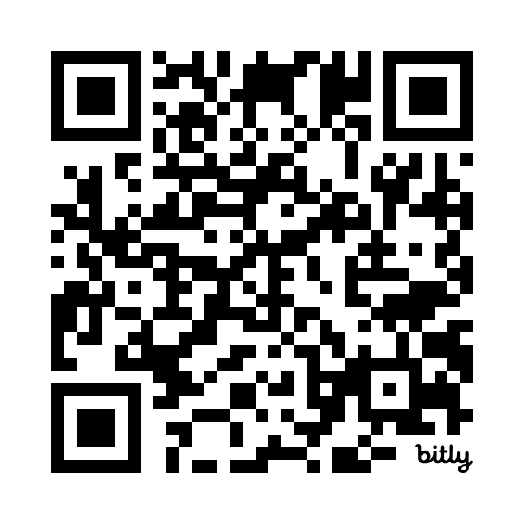
p-values app: peter1328.shinyapps.io/pvalues/
Teaching method A
Pretest
Posttest
Teaching method B
Pretest
Posttest
https://forms.gle/hWpwiob89KFiEaMt6
Notes:
Imagine reading a paper in which two teaching methods are compared in an experimental study.
For both teaching methods, CLICK pretests and posttests assessing learners’ knowledge are conducted.

Slide 30
p-values app: peter1328.shinyapps.io/pvalues/
Teaching method A
Pretest
Posttest
Teaching method B
Pretest
Posttest
Go into the p-values app. Start with the default values: n = 60 per group, d = 0.6.
Group A: Decrease the sample size in steps of 10. Predict: What will happen to the power, does it go up or down and how strongly? Observe: What happens? Explain: It is in accordance with your prediction? Why, why not?
Group B: Decrease the effect size in steps of .10. Predict: What will happen to the power, does it go up or down and how strongly? Observe: What happens? Explain: It is in accordance with your prediction? Why, why not?
Notes:
Imagine reading a paper in which two teaching methods are compared in an experimental study.
For both teaching methods, CLICK pretests and posttests assessing learners’ knowledge are conducted.

Slide 31
t(49) = 2.11, p < .05
Teaching method A
Pretest
Posttest
t(49) = 1.60, p > .10
Teaching method B
Pretest
Posttest
Interpretation:
«Under Teaching method B there were no learning gains, teaching method A works better!»
Notes:
Repeated measures t-tests are conducted and
For learning gains under teaching method A, there is a p-value below .05.
For learning gains under teaching method B, there is a p-value above .05.
The interpretation is
«Under Teaching method B there were no learning gains, teaching method A works better!
There are two common misinterpretations of p-values > .05 in this interpretation:

Slide 32
A low p-value does not indicate correctness of a hypothesis.
t(49) = 2.11, p < .05
Teaching method A
Pretest
Posttest
Difference in significance does not indicate difference in effects
t(49) = 1.60, p > .10
Teaching method B
Pretest
Posttest
p > .05 does not indicate the absence of an effect.
Wagenmakers, 2007
Niewenhuis et al., 2011
Gelman & Loken, 2006
Morey et al., 2015
Edelsbrunner & Thurn, 2024
Notes:
The first misinterpretation is that the p-value > .05 indicates that there is no effect,
The second misinterpretation is that the difference in significance levels – below .05 vs. above .05 – indicates that the learning effects differed between each other.
However, from a p-value > .05 sadly we cannot conclude anything – either there is no effect, or we just did not find it. Also, a difference in p-values does not yet indicate a difference in effects – this would have to be tested directly.
Empirical research has repeatedly shown that from psychology undergraduates to experienced researchers, people make these mistakes and put them in their papers.

Slide 33
Statistical significance
p-value < .05: «There is an effect»?
p...
...disproves the null hypothesis of no difference.
...proves the alternative hypothesis.
...indicates the probability of the null hypothesis being true.
...indicates the probability of the alternative hypothesis being true.
...indicates the probability of the experimental hypothesis being true.
...indicates the probability of a wrong decision in case we reject the null hypothesis.
...indicates that in more than 95% of cases, we would obtain a significant result when repeating the experiment.
...indicates the probability of the data or more extreme data given that the null hypothesis is true.
Notes:
Ich schätze diesen Mittelwert (1.55) – wie unsicher ist diese Schätzung? (Ich habe ja nur eine begrenzte Stichprobe).
Lösung: Wir haben Information über die Streuung in der Population, die wir nämlich in der Standardabweichung zusammengefasst haben.
Dieser Stichprobenwert kann also einen Hinweis darauf geben, wie stark die Werte in der Population schwanken.
Je mehr Werte wir aus der Population ziehen, desto weniger werden diese schwanken – der Standardfehler unserer Mittelwertsschätzungen wird somit geringer werden – sie nähern sich im Schnitt immer Stärker dem wahren Populationsmittelwert an – ihre Varianz wird also geringer.
CI v.s Capture Percentage (CP):
https://www.r-bloggers.com/the-difference-between-a-confidence-interval-and-a-capture-percentage/

Slide 34
Statistical significance
p-value < .05: «There is an effect»?
p...
...disproves the null hypothesis of no difference.
...proves the alternative hypothesis.
...indicates the probability of the null hypothesis being true.
...indicates the probability of the alternative hypothesis being true.
...indicates the probability of the experimental hypothesis being true.
...indicates the probability of a wrong decision in case we reject the null hypothesis.
...indicates that in more than 95% of cases, we would obtain a significant result when repeating the experiment.
...indicates the probability of the data or more extreme data given that the null hypothesis is true.
Notes:
Ich schätze diesen Mittelwert (1.55) – wie unsicher ist diese Schätzung? (Ich habe ja nur eine begrenzte Stichprobe).
Lösung: Wir haben Information über die Streuung in der Population, die wir nämlich in der Standardabweichung zusammengefasst haben.
Dieser Stichprobenwert kann also einen Hinweis darauf geben, wie stark die Werte in der Population schwanken.
Je mehr Werte wir aus der Population ziehen, desto weniger werden diese schwanken – der Standardfehler unserer Mittelwertsschätzungen wird somit geringer werden – sie nähern sich im Schnitt immer Stärker dem wahren Populationsmittelwert an – ihre Varianz wird also geringer.
CI v.s Capture Percentage (CP):
https://www.r-bloggers.com/the-difference-between-a-confidence-interval-and-a-capture-percentage/

Slide 35
Statistical significance
p-value < .05: «There is an effect»?
p-value: % wrong decisions across many experiments
NOT
Whether there is an effect
Whether the null hypothesis is correct
Whether the alternative hypothesis is correct
The probability, that I am right/wrong with inferences from my present experiment
Decision making help that can work across many statistical tests and experiments
Notes:
Ich schätze diesen Mittelwert (1.55) – wie unsicher ist diese Schätzung? (Ich habe ja nur eine begrenzte Stichprobe).
Lösung: Wir haben Information über die Streuung in der Population, die wir nämlich in der Standardabweichung zusammengefasst haben.
Dieser Stichprobenwert kann also einen Hinweis darauf geben, wie stark die Werte in der Population schwanken.
Je mehr Werte wir aus der Population ziehen, desto weniger werden diese schwanken – der Standardfehler unserer Mittelwertsschätzungen wird somit geringer werden – sie nähern sich im Schnitt immer Stärker dem wahren Populationsmittelwert an – ihre Varianz wird also geringer.
CI v.s Capture Percentage (CP):
https://www.r-bloggers.com/the-difference-between-a-confidence-interval-and-a-capture-percentage/

Slide 36
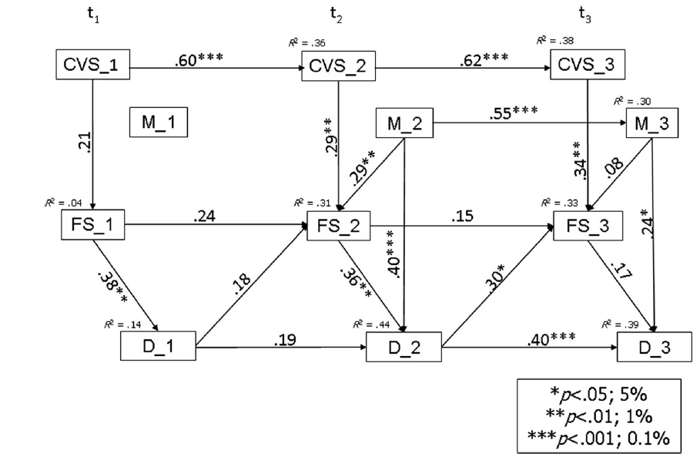
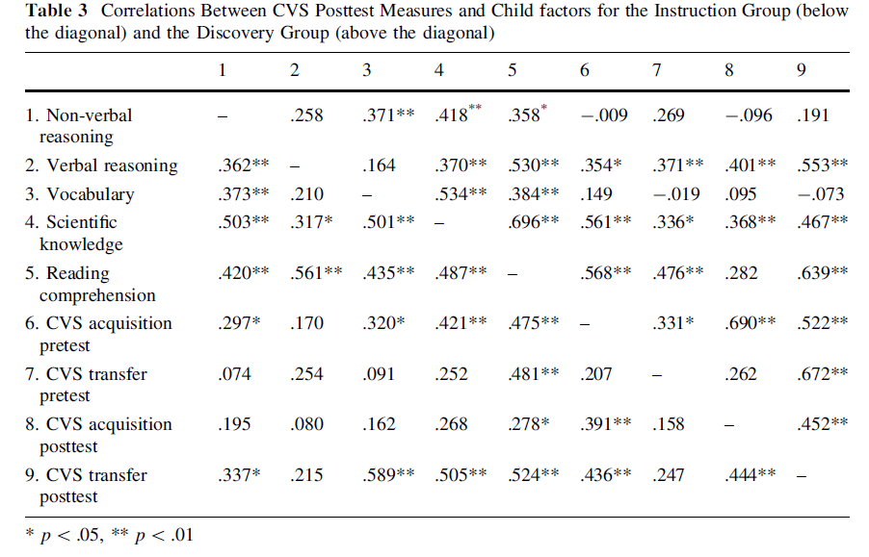
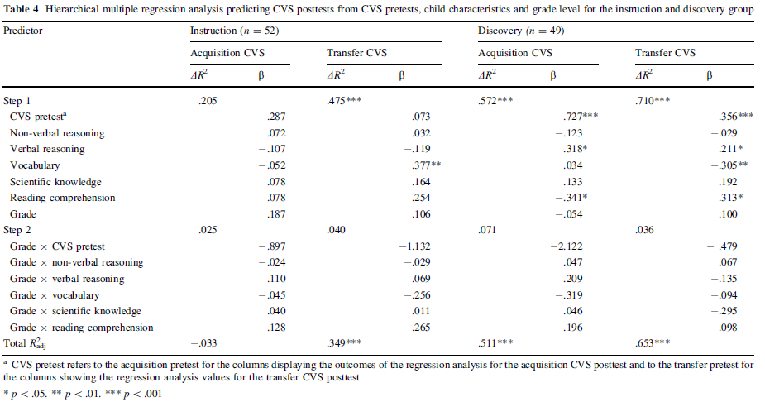
Statistical significance
p-value < .05: What should we do?
Bad practice:
Compute many p-values, interpret p < .05: «There is an effect», p > .05 «There is no effect» (Example: Most articles from the generally good journal «Instructional Science»; e.g.: Wagensveld et al., 2015; Zoupidis et al., 2016)
Notes:
A p-value is not very informative

Slide 37
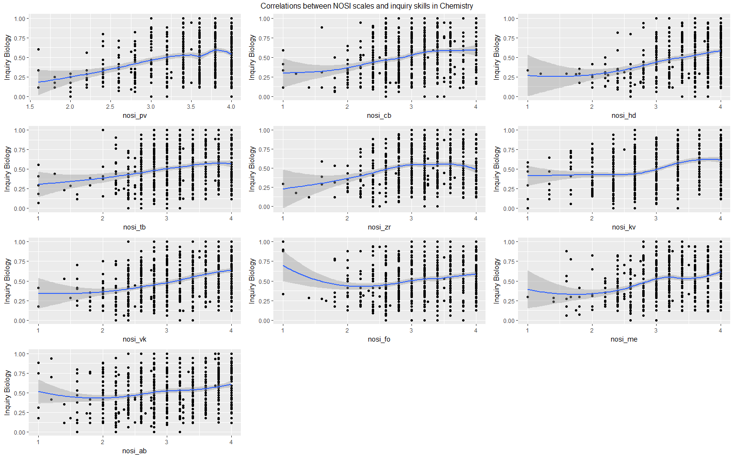
Statistical significance
p-value < .05: What should we do?
Bad practice:
Compute many p-values, interpret p < .05: «There is an effect», p > .05 «There is no effect»
Better practice:
Compute fewer, more targeted p-values
Additionally, report effect sizes with confidence intervals, descriptive statistics, and informative visualizations of the data.
Notes:
Ich schätze diesen Mittelwert (1.55) – wie unsicher ist diese Schätzung? (Ich habe ja nur eine begrenzte Stichprobe).
Lösung: Wir haben Information über die Streuung in der Population, die wir nämlich in der Standardabweichung zusammengefasst haben.
Dieser Stichprobenwert kann also einen Hinweis darauf geben, wie stark die Werte in der Population schwanken.
Je mehr Werte wir aus der Population ziehen, desto weniger werden diese schwanken – der Standardfehler unserer Mittelwertsschätzungen wird somit geringer werden – sie nähern sich im Schnitt immer Stärker dem wahren Populationsmittelwert an – ihre Varianz wird also geringer.
CI v.s Capture Percentage (CP):
https://www.r-bloggers.com/the-difference-between-a-confidence-interval-and-a-capture-percentage/

Slide 38

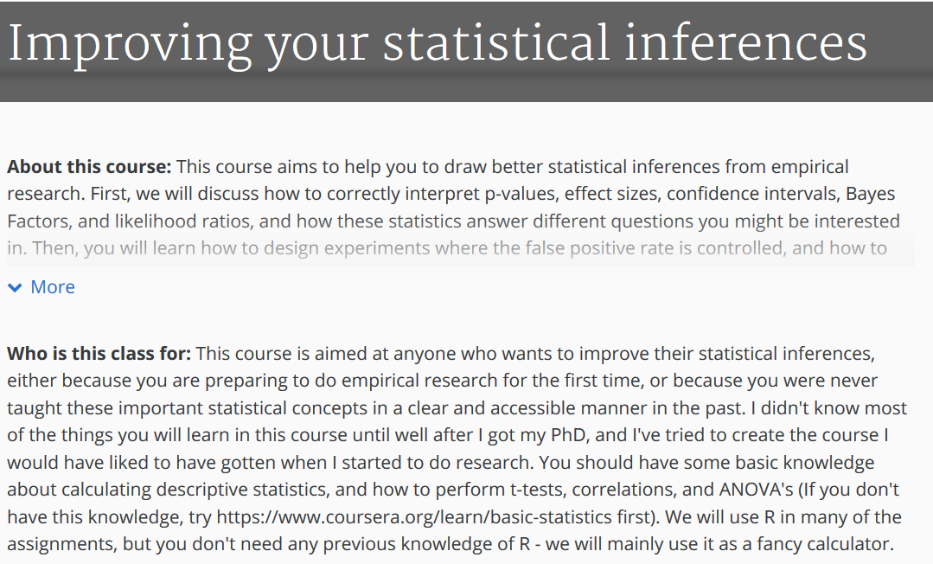
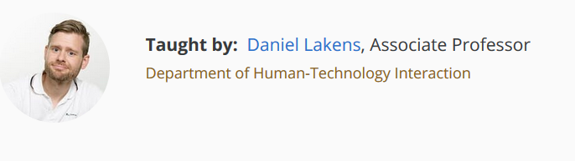
Where to learn about it?
p-value < .05: «There is an effect»?
Zoltan Dienes: Understanding Psychology as a Science
Wagenmakers (2007) A Practical Solution to the Pervasive Problems of p-Values
https://link.springer.com/article/10.3758/BF03194105
Online-course (free): Improving your Statistical Inferences
https://www.coursera.org/learn/statistical-inferences
Notes:
Ich schätze diesen Mittelwert (1.55) – wie unsicher ist diese Schätzung? (Ich habe ja nur eine begrenzte Stichprobe).
Lösung: Wir haben Information über die Streuung in der Population, die wir nämlich in der Standardabweichung zusammengefasst haben.
Dieser Stichprobenwert kann also einen Hinweis darauf geben, wie stark die Werte in der Population schwanken.
Je mehr Werte wir aus der Population ziehen, desto weniger werden diese schwanken – der Standardfehler unserer Mittelwertsschätzungen wird somit geringer werden – sie nähern sich im Schnitt immer Stärker dem wahren Populationsmittelwert an – ihre Varianz wird also geringer.
CI v.s Capture Percentage (CP):
https://www.r-bloggers.com/the-difference-between-a-confidence-interval-and-a-capture-percentage/

Slide 39
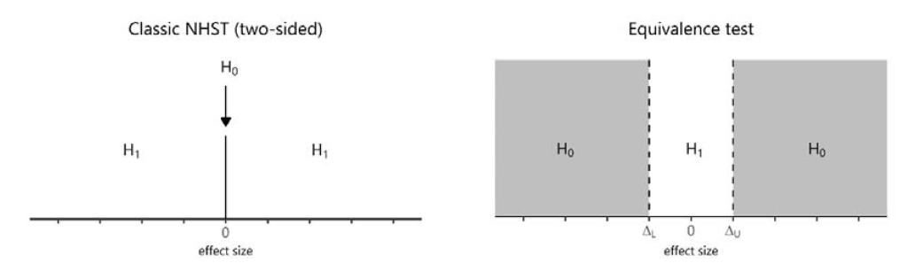
p > .05 – and now?
Rejection of null hypothesis not supported.
Interpret the effect size with confidence interval.
Options:
Direct testing of null hypothesis: Equivalence testing (Lakens McLatchie, Isager, Scheel, & Dienes, 2018)
Bayesian testing (Bayes factor)
Publish it (example).
Is there no (i.e., not more than a negligible) effect?
Is there an effect?
Notes:
Eine Lernforscherin hat eine Hypothese dazu, was eine spezifische Lehrmethode effektiv macht.
Sie führt ein Experiment durch in dem 50 Studierende mit dieser Lehrmethode lernen,
Eine Vergleichsgruppe B von 50 weiteren Studierenden lernt ohne diese Eigenschaft.

Slide 40
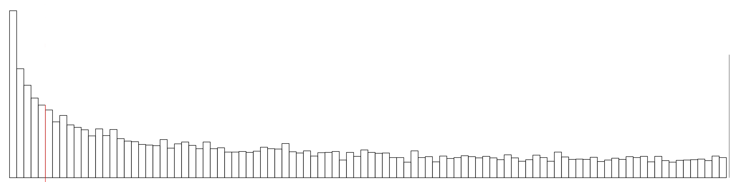
Crazy stuff: What happens when the real effect size is 0?
Notes:
Repeated measures t-tests are conducted and
For learning gains under teaching method A, there is a p-value below .05.
For learning gains under teaching method B, there is a p-value above .05.
The interpretation is
«Under Teaching method B there were no learning gains, teaching method A works better!
There are two common misinterpretations of p-values > .05 in this interpretation:

Slide 41
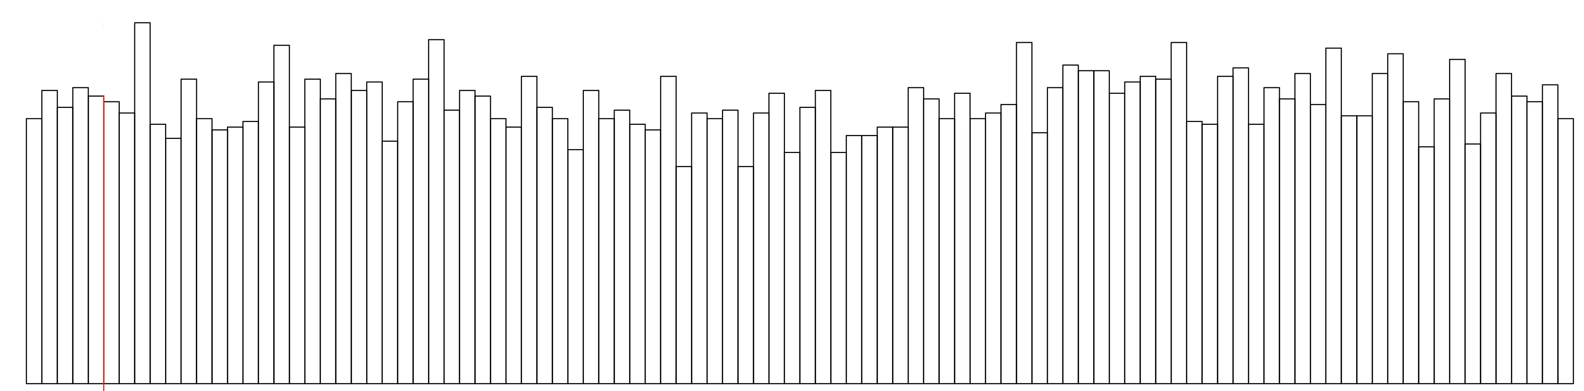
Crazy stuff: What happens when the real effect size is 0?
Notes:
Repeated measures t-tests are conducted and
For learning gains under teaching method A, there is a p-value below .05.
For learning gains under teaching method B, there is a p-value above .05.
The interpretation is
«Under Teaching method B there were no learning gains, teaching method A works better!
There are two common misinterpretations of p-values > .05 in this interpretation:

Slide 42
Crazy stuff: What happens when the real effect size is 0?
Notes:
Repeated measures t-tests are conducted and
For learning gains under teaching method A, there is a p-value below .05.
For learning gains under teaching method B, there is a p-value above .05.
The interpretation is
«Under Teaching method B there were no learning gains, teaching method A works better!
There are two common misinterpretations of p-values > .05 in this interpretation:

Slide 43
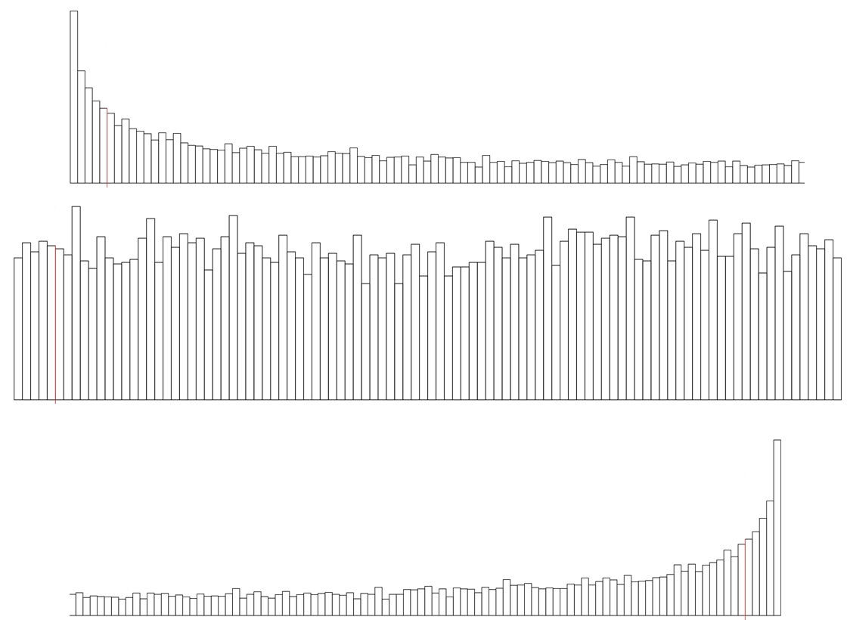
Crazy stuff: What happens when the real effect size is 0?
p-values app: peter1328.shinyapps.io/pvalues/
Go into the p-values app. Start with the default values: n = 60 per group, d = 0.6.
How will the distribution of p-values look like when the true effect size is 0?
Group A: Predict – observe – explain. What does it tell you about what the Alpha (Type I) and the Beta (Type II) errors mean?
Group B: Predict – observe – explain. What does this tell you about the meaning of a significant result, and what about the meaning of a non-significant result?
Notes:
Repeated measures t-tests are conducted and
For learning gains under teaching method A, there is a p-value below .05.
For learning gains under teaching method B, there is a p-value above .05.
The interpretation is
«Under Teaching method B there were no learning gains, teaching method A works better!
There are two common misinterpretations of p-values > .05 in this interpretation:

Slide 44
A non-significant p-value does not allow any conclusions, because...
...in significance testing, we assume that H0 is correct.
...it could either indicate that H0 is correct, or a beta-error. We do not know which of these is the case.
Do researchers know this? Edelsbrunner & Thurn (2024)
50 articles from education
(IF: M = 3.14, SD = 1.16)
528 hypotheses
253 (48%)
non-significant
142 (53%)
"no effect"-interpretation
Notes:
There is no left-skewed distribution of p-values

Slide 45
Statistics comes before data collection
30 participants per condition are minimum
p-values indicate whether our Hypotheses are correct “A significant p-value – my study was successful!”
Participants with missing data should not be analyzed
Asking a statistician ensures everything’s right
There is one statistical model for each study design
Notes:
I) Uncertainty -> plan your sample size
II) Visual inspection -> Look into your data
III) Missing data -> Don’t throw them away
IV) Significance testing (p-values) -> Beware
IV) Model choice -> Answer your question
I) Uncertainty -> plan your sample size
II) Visual inspection -> Look into your data
III) Missing data -> Don’t throw them away
IV) Significance testing (p-values) -> Beware
V) Model choice -> Answer your question
VI) Statistics comes in the end -> Beginning
VII) Statisticians know what they are talking about -> Don’t believe a single one, believe many

Slide 46
Statistics comes before data collection
30 participants per condition are minimum
p-values indicate nothing our Hypotheses are correct “A significant p-value – not as important as careful data analyses and interpretations!”
Participants with missing data should not be analyzed
Asking a statistician ensures everything’s right
There is one statistical model for each study design
Notes:
I) Uncertainty -> plan your sample size
II) Visual inspection -> Look into your data
III) Missing data -> Don’t throw them away
IV) Significance testing (p-values) -> Beware
IV) Model choice -> Answer your question
I) Uncertainty -> plan your sample size
II) Visual inspection -> Look into your data
III) Missing data -> Don’t throw them away
IV) Significance testing (p-values) -> Beware
V) Model choice -> Answer your question
VI) Statistics comes in the end -> Beginning
VII) Statisticians know what they are talking about -> Don’t believe a single one, believe many

Slide 47
Statistics comes before data collection
30 participants per condition are minimum
p-values indicate nothing
Participants with missing data should not be analyzed “This one missed an assessment, let’s drop him/her from the datafile!”
Asking a statistician ensures everything’s right
There is one statistical model for each study design
Notes:
I) Uncertainty -> plan your sample size
II) Visual inspection -> Look into your data
III) Missing data -> Don’t throw them away
IV) Significance testing (p-values) -> Beware
IV) Model choice -> Answer your question
I) Uncertainty -> plan your sample size
II) Visual inspection -> Look into your data
III) Missing data -> Don’t throw them away
IV) Significance testing (p-values) -> Beware
V) Model choice -> Answer your question
VI) Statistics comes in the end -> Beginning
VII) Statisticians know what they are talking about -> Don’t believe a single one, believe many

Slide 48
Handling Missing data
Scenario:
Participants miss one assessment (e.g., pre- or posttest)
or do not answer all questions/items of a questionnaire/test
Option 1:
Delete these participants
Option 2:
Analyze the available data

Slide 49
Handling Missing data
Scenario A:
A participant misses the session in which they worked on the posttest.
What do you do with the data of that participant?
If the data set is big enough – throw them out/don`t care.
Evaluate the reason: What data did you ahve of that person?
If you only have a pretest, that could still be helpful! «Bayesian approach» – predict what would have been there?
Scenario B:
A participant does not fill out all items of the posttest.
What do you do with the data of that participant?
Check the research question: Learning gain -> throw out. Maybe use the parts that are filled out properly? Utilize as much data as we can? But: Many statistical estimators will throw partialyl missing data out.
Don`t know the reasons for the missingness (!) – compute a mean scores of the avilable responses
Scenario C:
It appears that a participant`s responses on the posttest are not trustworthy.
What do you do with the data of that participant?
Step 1: Determine whether the data are trustworthy – statistically.
If unsure: Shouldn`t throw them out. Maybe trustworthiness doesn`t
Cheating: Throw the data out. E.g. learning gain: Needs to be thrown out.
Lack of trustworthniess may cancel out?
Do we throw out outlierts? What`s the difference between outliers and non-trustworthy?
Ideal condition vs. ecological validity ->

Slide 50
Handling Missing data
Scenario:
Participants miss one assessment (e.g., pre- or posttest)
or do not answer all questions/items of a questionnaire/test
Option 1:
Delete these participants
Option 2:
Analyze the available data
Bad option
Good option

Slide 51
Handling Missing data
Scenario:
Participants miss one assessment (e.g., pre- or posttest)
or do not answer all questions/items of a questionnaire/test
Option 1:
Delete these participants
This makes the assumption that participants with missing data are exactly the same as those with full data (missings are completely at random; MCAR).
In other words, they tend to have the same values on all variables that you have assessed, and on other non-assessed variables.
This is unrealistic, hinders generalizability and perhaps randomization (!).
And:
Dropping data means dropping information and thereby decrease in Power.
Notes:
There are seldom reasons to assume that participants who did not answer all questions or attend all assessment sessions did not participate properly in the study (and even then, it’s problematic to just exclude their data).

Slide 52
Handling Missing data
Scenario:
Participants miss one assessment (e.g., pre- or posttest)
or do not answer all questions/items of a questionnaire/test
Option 2:
Analyze all available data
There are two common and good ways to deal with partially missing data:
Full information maximum likelihood estimation -> just use all data points that are there. Possible in SPSS (linear mixed model), R (linear mixed model; lme4, afex; structural equation or path model, lavaan package); Mplus software package
Multiple imputation (Stef van Buuren) -> estimate missing data (yes, it’s ok)
stefvanbuuren.name/fimd/

Slide 53

Statistics comes before data collection
30 participants per condition are minimum
p-values indicate nothing
Participants with missing data should not be analyzed “This one missed an assessment, let’s drop him/her from the datafile!”
Asking a statistician ensures everything’s right
There is one statistical model for each study design
Notes:
I) Uncertainty -> plan your sample size
II) Visual inspection -> Look into your data
III) Missing data -> Don’t throw them away
IV) Significance testing (p-values) -> Beware
IV) Model choice -> Answer your question
I) Uncertainty -> plan your sample size
II) Visual inspection -> Look into your data
III) Missing data -> Don’t throw them away
IV) Significance testing (p-values) -> Beware
V) Model choice -> Answer your question
VI) Statistics comes in the end -> Beginning
VII) Statisticians know what they are talking about -> Don’t believe a single one, believe many

Slide 54
Statistics comes before data collection
30 participants per condition are minimum
p-values indicate nothing
Participants with missing data should always be analyzed “Let’s include all participants, the statistical algorithm will take care about everything!”
Asking a statistician ensures everything’s right
There is one statistical model for each study design
Notes:
I) Uncertainty -> plan your sample size
II) Visual inspection -> Look into your data
III) Missing data -> Don’t throw them away
IV) Significance testing (p-values) -> Beware
IV) Model choice -> Answer your question
I) Uncertainty -> plan your sample size
II) Visual inspection -> Look into your data
III) Missing data -> Don’t throw them away
IV) Significance testing (p-values) -> Beware
V) Model choice -> Answer your question
VI) Statistics comes in the end -> Beginning
VII) Statisticians know what they are talking about -> Don’t believe a single one, believe many

Slide 55
Statistics comes before data collection
30 participants per condition are minimum
p-values indicate nothing
Participants with missing data should always be analyzed
Asking a statistician ensures everything’s right “Perhaps, I should ask someone with more experience how to analyze my data!”
There is one statistical model for each study design
Notes:
I) Uncertainty -> plan your sample size
II) Visual inspection -> Look into your data
III) Missing data -> Don’t throw them away
IV) Significance testing (p-values) -> Beware
IV) Model choice -> Answer your question
I) Uncertainty -> plan your sample size
II) Visual inspection -> Look into your data
III) Missing data -> Don’t throw them away
IV) Significance testing (p-values) -> Beware
V) Model choice -> Answer your question
VI) Statistics comes in the end -> Beginning
VII) Statisticians know what they are talking about -> Don’t believe a single one, believe many

Slide 56
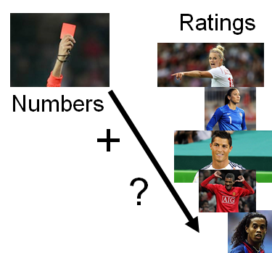
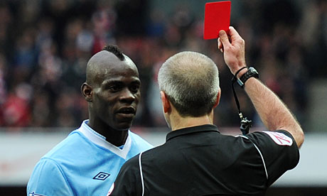
Silberzahn, R., et al. (2015). Crowdsourcing data analysis: Do soccer referees give more red cards to dark skin toned players? Center for Open Science, https://osf.io/j5v8f/
29 Teams of statisticians from all world
Same dataset. Same question

Slide 57
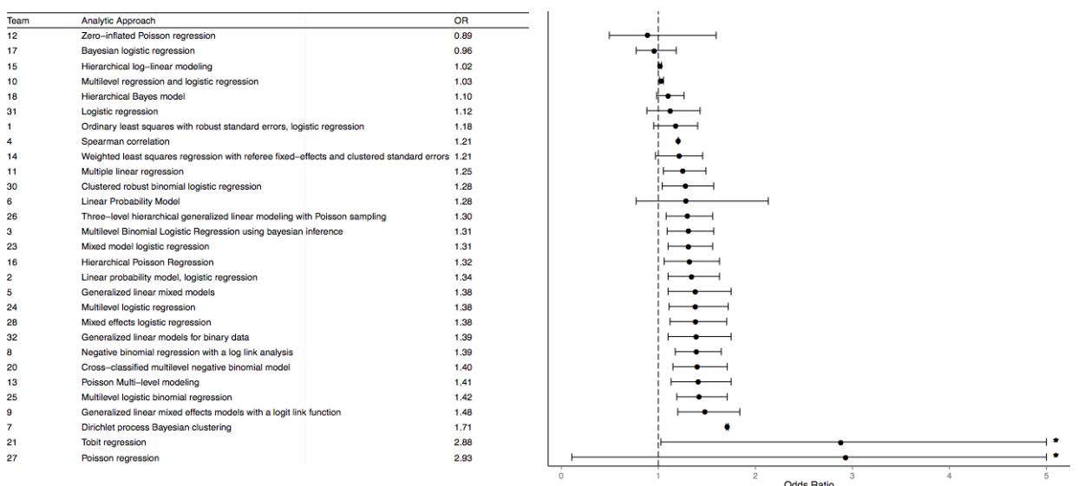
Silberzahn, R., et al. (2015). Crowdsourcing data analysis: Do soccer referees give more red cards to dark skin toned players? Center for Open Science, https://osf.io/j5v8f/
29 Teams of statisticians from all world
Same dataset. Same question
What do they do? What do they find?

Slide 58
Statistics comes before data collection
30 participants per condition are minimum
p-values indicate nothing
Participants with missing data should always be analyzed
Asking a statistician is useful and brings up potential ideas “I should ask at least two people with more experience how to analyze my data!”
There is one statistical model for each study design
Notes:
I) Uncertainty -> plan your sample size
II) Visual inspection -> Look into your data
III) Missing data -> Don’t throw them away
IV) Significance testing (p-values) -> Beware
IV) Model choice -> Answer your question
I) Uncertainty -> plan your sample size
II) Visual inspection -> Look into your data
III) Missing data -> Don’t throw them away
IV) Significance testing (p-values) -> Beware
V) Model choice -> Answer your question
VI) Statistics comes in the end -> Beginning
VII) Statisticians know what they are talking about -> Don’t believe a single one, believe many

Slide 59
Statistics comes before data collection
30 participants per condition are minimum
p-values indicate nothing
Participants with missing data should always be analyzed
Asking a statistician is useful and brings up potential ideas
There is one statistical model for each study design “A repeated measures ANOVA is the gold standard!”
Notes:
I) Uncertainty -> plan your sample size
II) Visual inspection -> Look into your data
III) Missing data -> Don’t throw them away
IV) Significance testing (p-values) -> Beware
IV) Model choice -> Answer your question
I) Uncertainty -> plan your sample size
II) Visual inspection -> Look into your data
III) Missing data -> Don’t throw them away
IV) Significance testing (p-values) -> Beware
V) Model choice -> Answer your question
VI) Statistics comes in the end -> Beginning
VII) Statisticians know what they are talking about -> Don’t believe a single one, believe many

Slide 60
Common statistical tests
t-Test
ANOVA
MANOVA
ANCOVA
Correlation
Multiple regression
Multiple AVs!
Number IVs
1
>=1
>=1
>1
1
>1
Levels IV 1
2
>=2
>=2
>=2
conti-nuous
conti-nuous
Levels IV 2
>=2
>=2
conti-nuous
>=2/cont.

Slide 61
Statistical tests
t-Test
Result
NumberIVs
1
Gender
Levels IV 1
2
male/female
t₄₇ = 2.11, p = .018
Levels IV 2

Slide 62
Statistical tests
ANOVA
Result
NumberIVs
>=1
Gender
Intervention
Levels IV 1
>=2
male/female
F_{1,47} = 2.11, p = .018
Interaction:
F_{5,43} = 5.43, p = .002
Levels IV 2
>=2
Intervention group
Control group
F_{2,46} = 0.90, p = .480

Slide 63
Common statistical tests
t-Test
ANOVA
MANOVA
ANCOVA
Correlation
Multiple regression
Multiple AVs!
Number IVs
1
>=1
>=1
>1
1
>1
Levels IV 1
2
>=2
>=2
>=2
conti-nuous
conti-nuous
Levels IV 2
>=2
>=2
conti-nuous
>=2/cont.

Slide 64
Models for pre- post- intervention – control group data
Question | Design | Model
Do groups differ at one time point? | Between | t-Test, ANOVA
Do groups change between time points? | Within | dep. t-Test, RMANOVA
Are there differences in changes between groups? | Within-between (mixed) | Multif. RMANOVA
Can individual differences be explained through covariates? | Within/between | ANCOVA, RMANCOVA, multiple Regression

Slide 65
Models for pre- post- data
Question | Model
Do effects differ between school classes, teachers, or schools? Do characteristics of the teacher interact with students’ learning? | Multilevel modeling
Does the intervention effect depend on student characteristics? | Linear mixed model, general additive model
Do the learners undergo knowledge restructuring? | Mixture modeling/Clustering
Which scores should be built from students’ answers? Is an overall score useful? | Item response theory, Rasch modeling, Confirmaotry factor analysis
Does the learners’ conceptual knowledge become more homogenous after the intervention? | Network modeling

Slide 66
Models for pre- post- data
Question | Model
Do effects differ between school classes, teachers, or schools? Do characteristics of the teacher interact with students’ learning? | Multilevel modeling
Does the intervention effect depend on student characteristics? | Linear mixed model, general additive model
Do the learners undergo knowledge restructuring? | Mixture modeling/Clustering
Which scores should be built from students’ answers? Is an overall score useful? | Item response theory, Rasch modeling, Confirmaotry factor analysis
Does the learners’ conceptual knowledge become more homogenous after the intervention? | Network modeling

Slide 67
Multilevel modeling
Problem: Our statistical model assumes that all data points are independent of each other
Educational science: Dependency within school classes
Solution 1: Individual model for each school class
Solution 2: Random effects (hierarchical/multilevel) model
Demonstration (Michael Freeman)
Our research:
Students from different classrooms, different teachers, repeated measures: Check the multilevel structure (e.g., whether effects differ between classrooms) of the data
Books: Hox et al., Finch et al.
Edelsbrunner et al. (in press)
+ distributional models:
Which condition produces how much variation between learners (location-scale models), minimum- or maximum scores (zero-/one-inflated models), which benefits weaker or stronger learners (quantile regression)?

Slide 68
Models for pre- post- data
Question | Model
Do effects differ between school classes, teachers, or schools? Do characteristics of the teacher interact with students’ learning? | Multilevel modeling
Does the intervention effect depend on student characteristics? | Linear mixed model, general additive model
Do the learners undergo knowledge restructuring? | Mixture modeling/Clustering
Which scores should be built from students’ answers? Is an overall score useful? | Item response theory, Rasch modeling, Confirmaotry factor analysis
Does the learners’ conceptual knowledge become more homogenous after the intervention? | Network modeling

Slide 69
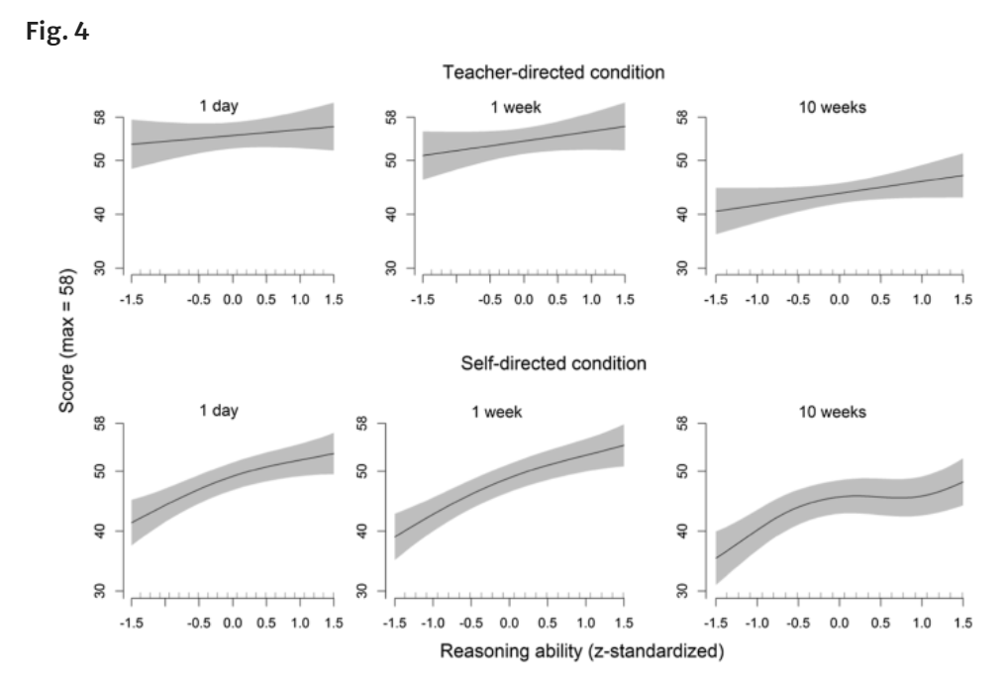
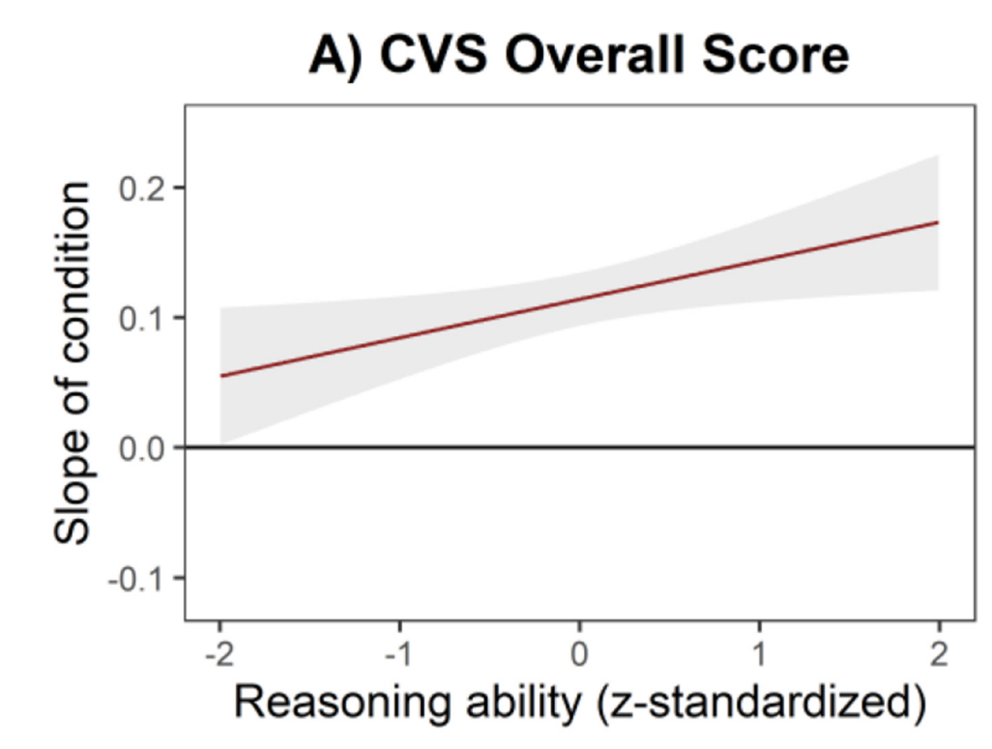
Differential Effects (Aptitude-Treatment Interactions)
Do differences between conditions (which student benefits from which condition) depend on learners’ characteristics/preconditions?
Interaction effects in (multilevel) regression models
Peteranderl et al. (2023)
Additive models
Ziegler et al. (2021)

Slide 70
Models for pre- post- data
Question | Model
Do effects differ between school classes, teachers, or schools? Do characteristics of the teacher interact with students’ learning? | Multilevel modeling
Does the intervention effect depend on student characteristics? | Linear mixed model, general additive model
Do the learners undergo knowledge restructuring? | Mixture modeling/Clustering
Which scores should be built from students’ answers? Is an overall score useful? | Item response theory, Rasch modeling, Confirmaotry factor analysis
Does the learners’ conceptual knowledge become more homogenous after the intervention? | Network modeling

Slide 71
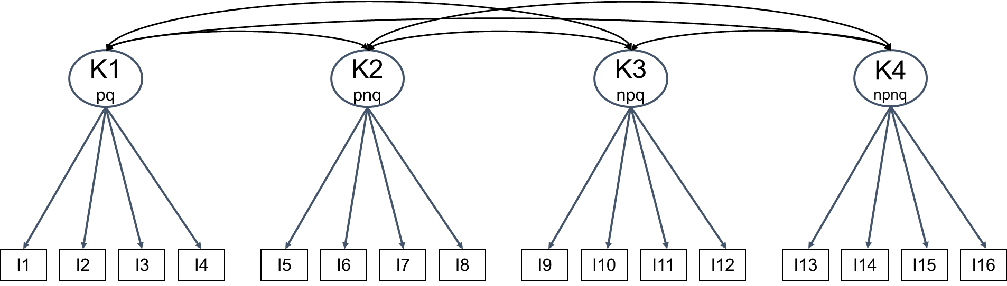
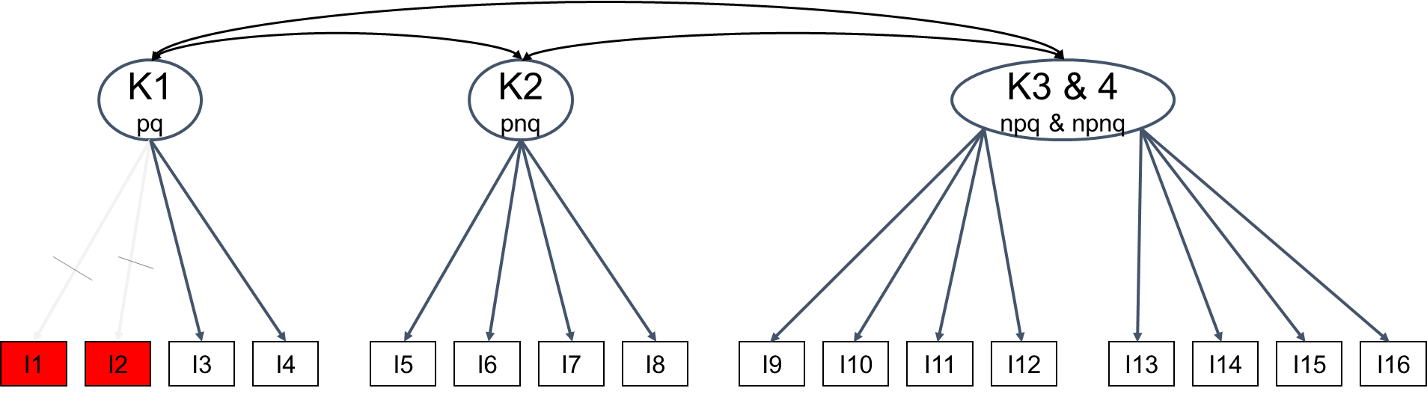
Confirmatory factor analysis
Initial model
CFA showed:
It is useful to build three scores – all irrelevant conditions should be combined into one score.
Two items should not be included because they don’t offer sufficient information.
An overall score is not useful and will lead to biased conclusions.
Final model
Grimm et al. (2023)

Slide 72
Models for pre- post- follow-up data
Question | Model
Do effects differ between school classes, teachers, or schools? Do characteristics of the teacher interact with students’ learning? | Multilevel modeling
Does the intervention effect depend on student characteristics? | Linear mixed model, general additive model
Do the learners undergo knowledge restructuring? | Mixture modeling/Clustering
Which scores should be built from students’ answers? Is an overall score useful? | Item response theory, Rasch modeling, Confirmaotry factor analysis
Does the learners’ conceptual knowledge become more homogenous after the intervention? | Network modeling

Slide 73
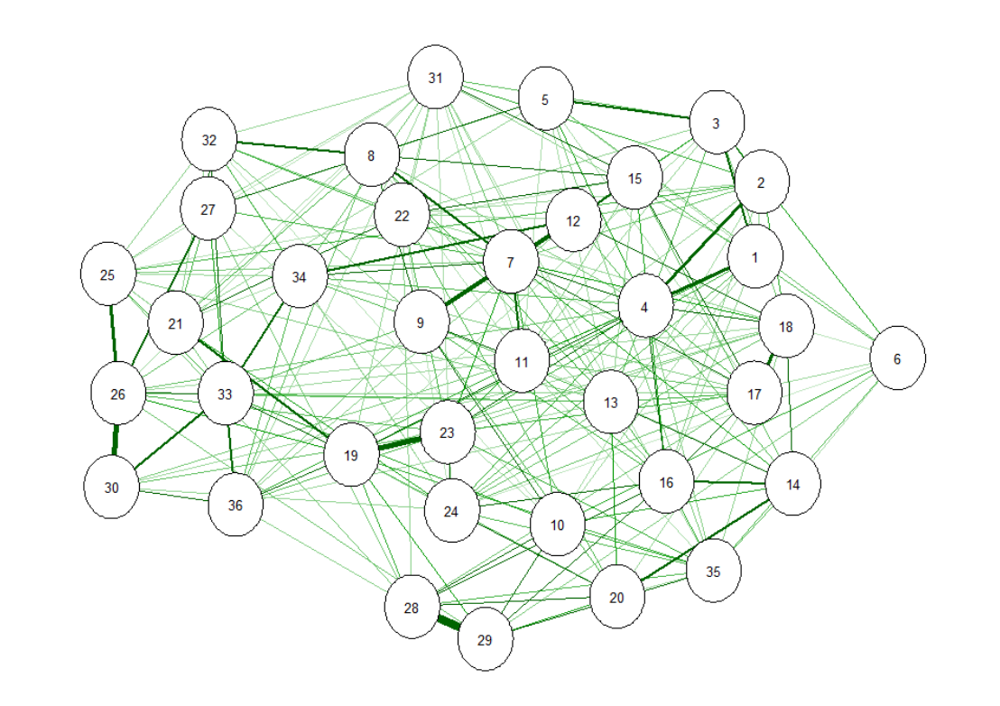
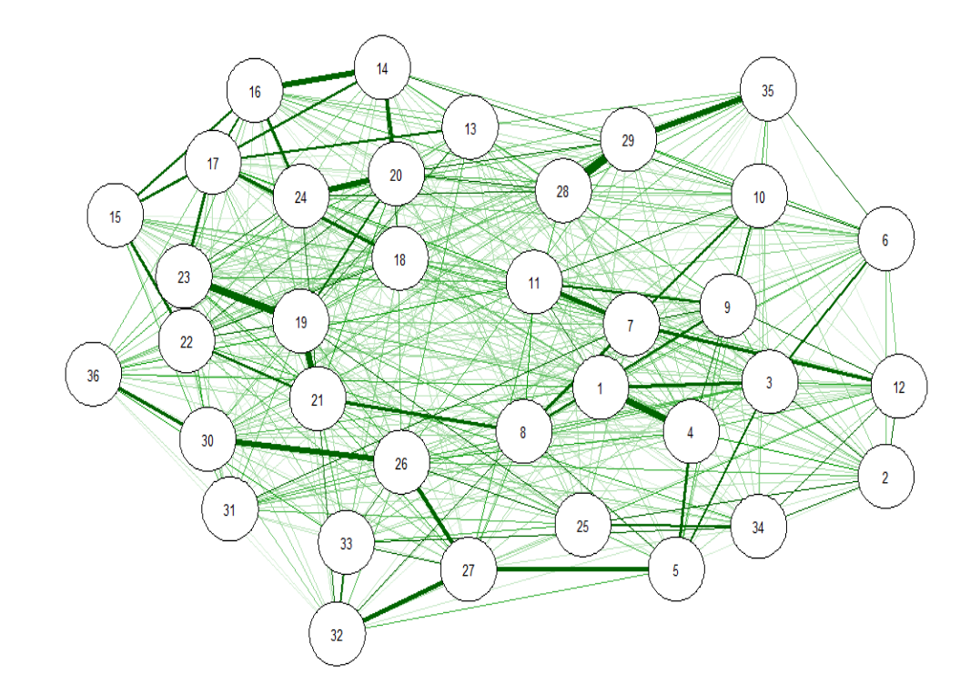
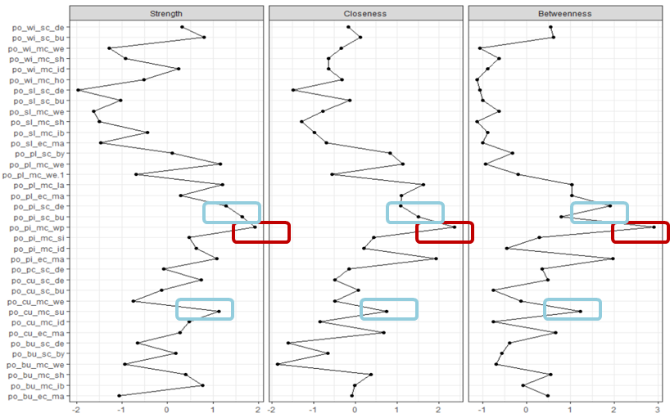
Network models: Knowledge structure
In the intervention group, students’ knowledge is more strongly interconnected after the intervention than in the control group.
Some conceptions are very central and migh be good targets to tackle in instruction

Slide 74
Models for pre- post- follow-up data
Question | Model
Do effects differ between school classes, teachers, or schools? Do characteristics of the teacher interact with students’ learning? | Multilevel modeling
Does the intervention effect depend on student characteristics? | Linear mixed model, general additive model
Do the learners undergo knowledge restructuring? | Mixture modeling/Clustering
Which scores should be built from students’ answers? Is an overall score useful? | Item response theory, Rasch modeling, Confirmaotry factor analysis
Does the learners’ conceptual knowledge become more homogenous after the intervention? | Network modeling
Are former concepts still present and do they show in learners’ answers or reaction time? | Diffusion model, IRT

Slide 75
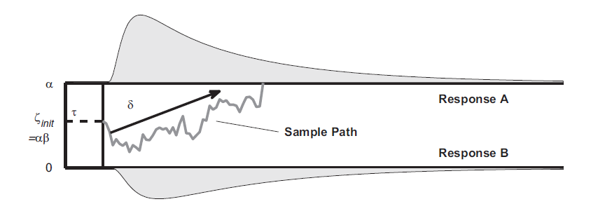
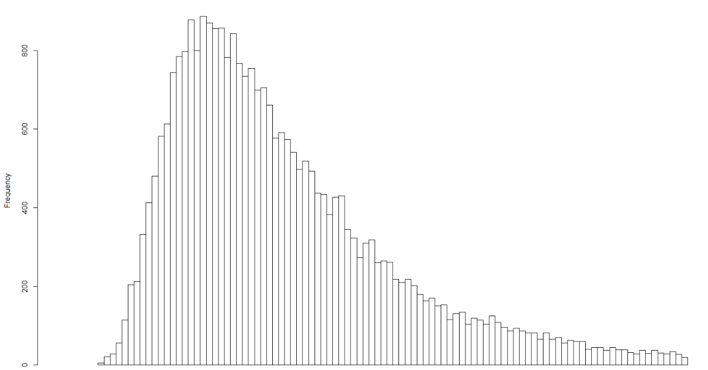
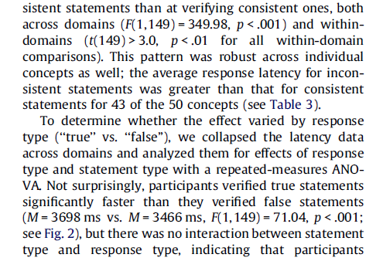
Wiener diffusion model
How to model this part of the reaction time?
Can we model both decisions and reaction times?

Slide 76
Models for pre- post- follow-up data
Question | Model
Do effects differ between school classes, teachers, or schools? Do characteristics of the teacher interact with students’ learning? | Multilevel modeling
Does the intervention effect depend on student characteristics? | Linear mixed model, general additive model
Do the learners undergo knowledge restructuring? | Mixture modeling/Clustering
Which scores should be built from students’ answers? Is an overall score useful? | Item response theory, Rasch modeling, Confirmaotry factor analysis
Does the learners’ conceptual knowledge become more homogenous after the intervention? | Network modeling
Which variables are the best predictors of learners’ knowledge? | SEM, Machine Learning relative importance

Slide 77
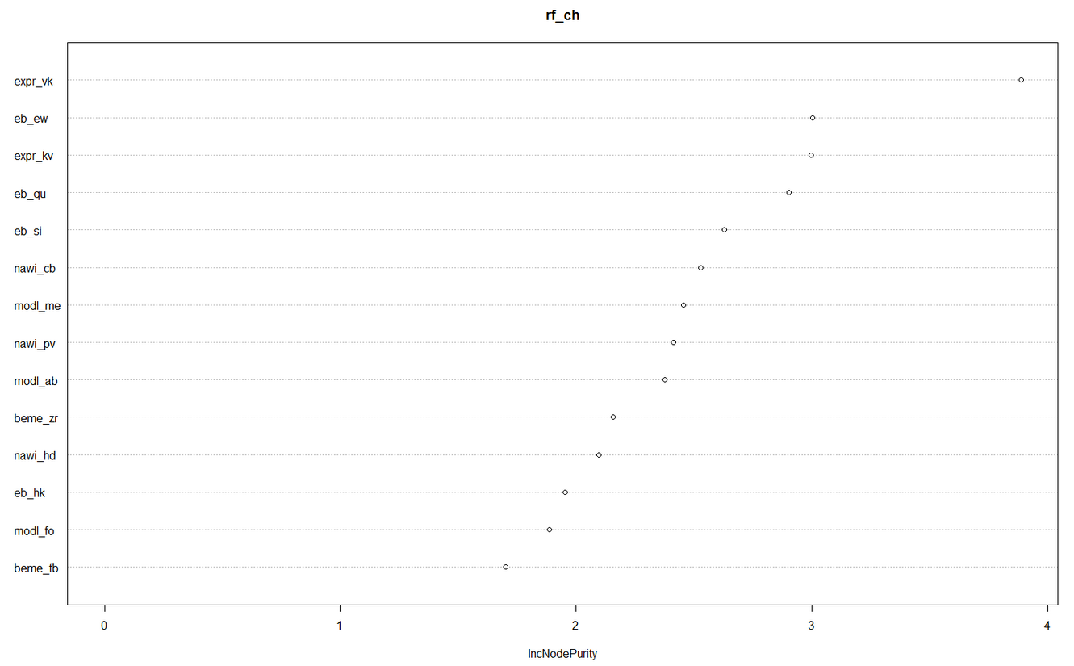
Machine learning
Predictive strength and value of multiple variables:
Random forest
Neural network
Generalized additive mixed models
-> These methods provide effect sizes and/or relative importance measures
Good for predictive purposes (catching non-linear, higher-order interactions), not so much for hypothesis testing (blackbox methodologies)
Hastie, Tibshirani – good, free book

Slide 78
Useful approaches for your PhD/research concerned with Knowledge Acquisition
Just wanna finish your PhD? Choose either of these!
1) Structural equation modeling
2) (Bayesian) multilevel modeling
3) Psychometrics (Rasch scaling & Item Response Theory)
4) Learning analytics (Markov Models, sequence analysis)
5) Network modeling
6) Predictive modeling (Machine Learning)
7) Cognitive process modeling (e.g., Diffusion model)
Wanna stay in research and become aaawesome?
Look into all of these!

Slide 79
Statistics comes before data collection
30 participants per condition are minimum
p-values indicate nothing
Participants with missing data should always be analyzed
Asking a statistician is useful and brings up potential ideas
There is one statistical model for each study design “A repeated measures ANOVA is the gold standard!”
Notes:
I) Uncertainty -> plan your sample size
II) Visual inspection -> Look into your data
III) Missing data -> Don’t throw them away
IV) Significance testing (p-values) -> Beware
IV) Model choice -> Answer your question
I) Uncertainty -> plan your sample size
II) Visual inspection -> Look into your data
III) Missing data -> Don’t throw them away
IV) Significance testing (p-values) -> Beware
V) Model choice -> Answer your question
VI) Statistics comes in the end -> Beginning
VII) Statisticians know what they are talking about -> Don’t believe a single one, believe many

Slide 80
Statistics comes before data collection
30 participants per condition are minimum
p-values indicate nothing
Participants with missing data should always be analyzed
Asking a statistician is useful and brings up potential ideas
There are multiple useful statistical models for each question “Let’s apply awesome models to get the most information out of our data, in the collection of which we put so much work!”
Notes:
I) Uncertainty -> plan your sample size
II) Visual inspection -> Look into your data
III) Missing data -> Don’t throw them away
IV) Significance testing (p-values) -> Beware
IV) Model choice -> Answer your question
I) Uncertainty -> plan your sample size
II) Visual inspection -> Look into your data
III) Missing data -> Don’t throw them away
IV) Significance testing (p-values) -> Beware
V) Model choice -> Answer your question
VI) Statistics comes in the end -> Beginning
VII) Statisticians know what they are talking about -> Don’t believe a single one, believe many

Slide 81
Statistics comes after data collection
30 participants per condition are great
p-values indicate whether our Hypotheses are correct
Participants with missing data should not be analyzed
Asking a statistician ensures everything’s right
There is one statistical model for each study design
Notes:
Take one of these that you find find most instriguing and do the following:
Reflect on the statement and note down your own thoughts and perspective on it: Do you agree with the statement?
If yes, why, if no, why not?

Slide 82
Statistics comes before, during, and after data collection
30 participants per condition are the absolute minimum
p-values indicate very little
Participants with missing data should always be analyzed
Asking at least two statisticians is very useful
There are many informative statistical models for each study
Notes:
I) Uncertainty -> plan your sample size
II) Visual inspection -> Look into your data
III) Missing data -> Don’t throw them away
IV) Significance testing (p-values) -> Beware
IV) Model choice -> Answer your question
I) Uncertainty -> plan your sample size
II) Visual inspection -> Look into your data
III) Missing data -> Don’t throw them away
IV) Significance testing (p-values) -> Beware
V) Model choice -> Answer your question
VI) Statistics comes in the end -> Beginning
VII) Statisticians know what they are talking about -> Don’t believe a single one, believe many

Slide 83
Practice
Go into 3 groups (2-3 people per group)
Choose the project of one of the group members (planning-phase would be perfect)
Note down 1-2 research questions (e.g., do verbal teacher scaffolds support learning better than worked examples?) + 1 additional research question (e.g., “do students with a high number of prior misconceptions learn less?”)
Describe how these questions should be analyzed:
Which measures (assessments), sample size, when do assessments take place, which variables will be built from the measures, what will you analyze; potentially: which statistical model, which barriers might arise?

Slide 84
Experimental condition
Pretest
Posttest
Control condition
Pretest
Posttest

Slide 85
Statistics comes after data collection “Now I have my data, let’s look for a model and analyze!”
30 participants per condition are great
p-values indicate whether our Hypotheses are correct
Participants with missing data should not be analyzed
Asking a statistician ensures everything’s right
There is one statistical model for each study design
Notes:
I) Uncertainty -> plan your sample size
II) Visual inspection -> Look into your data
III) Missing data -> Don’t throw them away
IV) Significance testing (p-values) -> Beware
IV) Model choice -> Answer your question
I) Uncertainty -> plan your sample size
II) Visual inspection -> Look into your data
III) Missing data -> Don’t throw them away
IV) Significance testing (p-values) -> Beware
V) Model choice -> Answer your question
VI) Statistics comes in the end -> Beginning
VII) Statisticians know what they are talking about -> Don’t believe a single one, believe many

Slide 86
Statistics comes after data collection
30 participants per condition are great “Let’s aim at 20-30 people in each group, that will be fine!”
p-values indicate whether our Hypotheses are correct
Participants with missing data should not be analyzed
Asking a statistician ensures everything’s right
There is one statistical model for each study design
Notes:
I) Uncertainty -> plan your sample size
II) Visual inspection -> Look into your data
III) Missing data -> Don’t throw them away
IV) Significance testing (p-values) -> Beware
IV) Model choice -> Answer your question
I) Uncertainty -> plan your sample size
II) Visual inspection -> Look into your data
III) Missing data -> Don’t throw them away
IV) Significance testing (p-values) -> Beware
V) Model choice -> Answer your question
VI) Statistics comes in the end -> Beginning
VII) Statisticians know what they are talking about -> Don’t believe a single one, believe many

Slide 87
Statistics comes after data collection
30 participants per condition are great
p-values indicate whether our Hypotheses are correct “A significant p-value – my study was successful!”
Participants with missing data should not be analyzed
Asking a statistician ensures everything’s right
There is one statistical model for each study design
Notes:
I) Uncertainty -> plan your sample size
II) Visual inspection -> Look into your data
III) Missing data -> Don’t throw them away
IV) Significance testing (p-values) -> Beware
IV) Model choice -> Answer your question
I) Uncertainty -> plan your sample size
II) Visual inspection -> Look into your data
III) Missing data -> Don’t throw them away
IV) Significance testing (p-values) -> Beware
V) Model choice -> Answer your question
VI) Statistics comes in the end -> Beginning
VII) Statisticians know what they are talking about -> Don’t believe a single one, believe many

Slide 88
Statistics comes after data collection
30 participants per condition are great
p-values indicate whether our Hypotheses are correct
Participants with missing data should not be analyzed “This one missed an assessment, let’s drop him/her from the datafile!”
Asking a statistician ensures everything’s right
There is one statistical model for each study design
Notes:
I) Uncertainty -> plan your sample size
II) Visual inspection -> Look into your data
III) Missing data -> Don’t throw them away
IV) Significance testing (p-values) -> Beware
IV) Model choice -> Answer your question
I) Uncertainty -> plan your sample size
II) Visual inspection -> Look into your data
III) Missing data -> Don’t throw them away
IV) Significance testing (p-values) -> Beware
V) Model choice -> Answer your question
VI) Statistics comes in the end -> Beginning
VII) Statisticians know what they are talking about -> Don’t believe a single one, believe many

Slide 89
Statistics comes after data collection
30 participants per condition are great
p-values indicate whether our Hypotheses are correct
Participants with missing data should not be analyzed
Asking a statistician ensures everything’s right “Perhaps, I should ask someone with more experience how to analyze my data!”
There is one statistical model for each study design
Notes:
I) Uncertainty -> plan your sample size
II) Visual inspection -> Look into your data
III) Missing data -> Don’t throw them away
IV) Significance testing (p-values) -> Beware
IV) Model choice -> Answer your question
I) Uncertainty -> plan your sample size
II) Visual inspection -> Look into your data
III) Missing data -> Don’t throw them away
IV) Significance testing (p-values) -> Beware
V) Model choice -> Answer your question
VI) Statistics comes in the end -> Beginning
VII) Statisticians know what they are talking about -> Don’t believe a single one, believe many

Slide 90
Statistics comes after data collection
30 participants per condition are great
p-values indicate whether our Hypotheses are correct
Participants with missing data should not be analyzed
Asking a statistician ensures everything’s right
There is one statistical model for each study design “A repeated measures ANOVA is the gold standard!”
Notes:
I) Uncertainty -> plan your sample size
II) Visual inspection -> Look into your data
III) Missing data -> Don’t throw them away
IV) Significance testing (p-values) -> Beware
IV) Model choice -> Answer your question
I) Uncertainty -> plan your sample size
II) Visual inspection -> Look into your data
III) Missing data -> Don’t throw them away
IV) Significance testing (p-values) -> Beware
V) Model choice -> Answer your question
VI) Statistics comes in the end -> Beginning
VII) Statisticians know what they are talking about -> Don’t believe a single one, believe many

Slide 91
Statistics comes after data collection
30 participants per condition are great
p-values indicate whether our Hypotheses are correct
Participants with missing data should not be analyzed
Asking a statistician ensures everything’s right
There is one statistical model for each study design
Notes:
I) Uncertainty -> plan your sample size
II) Visual inspection -> Look into your data
III) Missing data -> Don’t throw them away
IV) Significance testing (p-values) -> Beware
IV) Model choice -> Answer your question
I) Uncertainty -> plan your sample size
II) Visual inspection -> Look into your data
III) Missing data -> Don’t throw them away
IV) Significance testing (p-values) -> Beware
V) Model choice -> Answer your question
VI) Statistics comes in the end -> Beginning
VII) Statisticians know what they are talking about -> Don’t believe a single one, believe many

Slide 92
“Why do we need statistical models, and how does this normal distribution curve come about?”
Notes:
I) Uncertainty -> plan your sample size
II) Visual inspection -> Look into your data
III) Missing data -> Don’t throw them away
IV) Significance testing (p-values) -> Beware
IV) Model choice -> Answer your question
I) Uncertainty -> plan your sample size
II) Visual inspection -> Look into your data
III) Missing data -> Don’t throw them away
IV) Significance testing (p-values) -> Beware
V) Model choice -> Answer your question
VI) Statistics comes in the end -> Beginning
VII) Statisticians know what they are talking about -> Don’t believe a single one, believe many

Slide 93
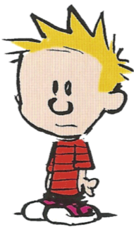
How does the normal distribution curve come about?
Notes:
In all standard statistical models, we make the assumption that our data are normally distributed.
…
Parameter estimation
Population variance
Variance of the estimator
Mean, standard deviation, standard error

Slide 94


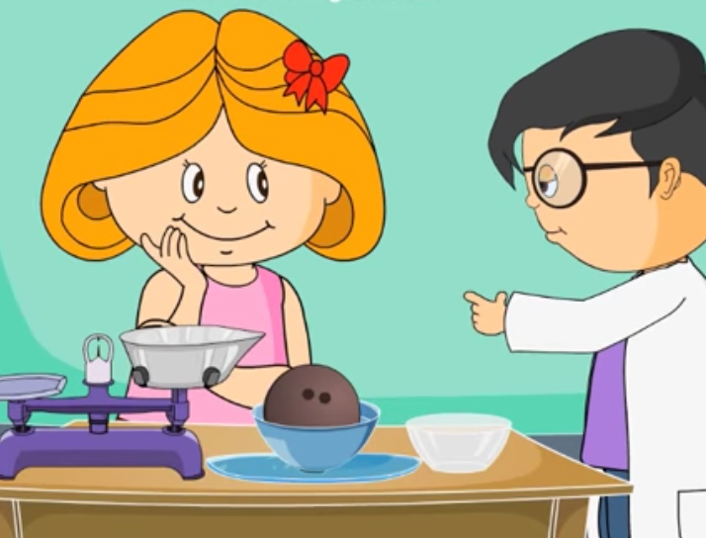

The sampling process
Pretest
Posttest
Learning gains
+3
+4
-5
0
+5
+1
-1
+2
-4
-2
-3
Notes:
Wie kommt eigentlich die Normalverteilungskurve zustande?

Slide 95


The sampling process
Pretest
Posttest
Learning gains
+3
+4
-5
0
+5
+1
-1
+2
-4
-2
-3
Notes:
Parameter: Numerische Charakteristik einer Population.

Slide 96

The sampling process
Pretest
Posttest
Learning gains
+3
+4
-5
0
+5
+1
-1
+2
-4
-2
-3
No, school is awesome!
School is boring!
Notes:
Calvin & Susie Derkins
Sampling: Not all students are the same – there is a process of variance

Slide 97
The sampling process
Pretest
Posttest
Learning gains
+3
+3
+4
+4
+5
-5
+5
-5
0
0
+1
+1
+2
-1
+2
-1
-2
-4
-2
-4
-3
-3
No, school is awesome!
School is boring!
97

Slide 98
The sampling process
Pretest
Posttest
Learning gains
+3
+4
+4
+5
-5
+5
-5
0
+1
-1
+2
-4
-2
-4
-3
-3
I slept so badly!
After the playground madness yesterday I slept like a baby!

Slide 99
The sampling process
Pretest
Posttest
Learning gains
+3
+4
-5
0
+5
+1
-1
+2
-4
-2
-3
I slept so badly!
After the playground madness yesterday I slept like a baby!

Slide 100
The sampling process
Pretest
Posttest
Learning gains
+3
+4
-5
0
+5
+1
-1
+2
-4
-2
-3
I don’t know anything about this stuff!
I have heard about this before – not all that is wooden swims, or something like that?

Slide 101
The sampling process
Pretest
Posttest
Learning gains
+3
+4
-5
0
+5
+1
-1
+2
-4
-2
-3
I don’t know anything about this stuff!
I have heard about this before – not all that is wooden swims, or something like that?
Notes:
Numerische Charakteristik einer Population.

Slide 102

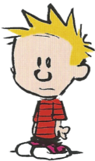
The sampling process
Pretest
Posttest
Learning gains
+3
+3
+4
+4
+5
-5
+5
-5
0
0
+1
+1
+2
-1
+2
-1
-2
-4
-2
-4
-3
-3
102
Notes:
Nun ziehen wir insgesamt in unserer Stichprobe 50 Schülerinnen und Schüler. Daraus ergibt sich diese Verteilung von Lernzugewinnen.
Es ist alles von -5 bis +5 dabei aber es zeigt sich ein Trend, dass die meisen 0-2 Punkte hinzugewinnen.
Was wir eigentlich wissen wollen ist nun nicht, wie gut der Unterricht bei diesen Schülerinnen und Schülern funktioniert hat, sondern was der zugrundeliegende Trend in der Gesamtpopulation ist:
Wir wollen schätzen, welcher Effekt in der Population, aus der wir unsere Schülerinnen und Schüler ziehen vorhanden ist – wir wollen also den Populationsparameter schätzen.
Da wir aber nur eine begrenzte Stichprobe haben, also einen Teil der Population, wird unsere Schätzung nicht ganz fehlerfrei sein – sie hat einen Stichprobenfehler.
Was wir nun mit Statistik Machen möchten, ist einen best guess abzugeben, wo der Wert in der Population liegt und wie sicher wir uns bei unserer Einschätzung sein können.

Slide 103

The sampling process
Pretest
Posttest
Learning gains
+3
+3
+4
+4
+5
-5
+5
-5
0
0
+1
+1
+2
-1
+2
-1
-2
-4
-2
-4
-3
-3
The normal distribution arises because there are multiple unknown factors in interplay that determine students’ learning
If we knew all these factors, we could perfectly predict how much each student learns! We don’t so we have to model probability (uncertainty).
Notes:
The normal distribution arises because there are multiple factors in interplay that determine students’ learning; when these are at average, a students reaches the average learning gain; in many students, these factors are close to the average students; in some cases, they are more extreme (e.g., a students is tired, has low prior knowledge, and is not interested in playing with water – such students do exist, but they are more rare than students who show at least a little bit interest, and the average students is also not super tired, at least not before adolescence.
Since there will always be uncertainty in our prediction – that is, we don’t know all the factors that determine students’ learning, a regular mathematical formula is not sufficient for describing what’s going on – we need to model probability or uncertainty, and therefore we need statistics.

Slide 104
The sampling process
Pretest
Posttest
Learning gains
+3
+3
+4
+4
+5
-5
+5
-5
0
0
+1
+1
+2
-1
+2
-1
-2
-4
-2
-4
-3
-3
The normal distribution arises because there are multiple unknown factors in interplay that determine students’ learning
- We want to know whether the intervention, across all students, has an impact and manages to put a little bit on top of the average learning gain
Notes:
The normal distribution arises because there are multiple factors in interplay that determine students’ learning; when these are at average, a students reaches the average learning gain; in many students, these factors are close to the average students; in some cases, they are more extreme (e.g., a students is tired, has low prior knowledge, and is not interested in playing with water – such students do exist, but they are more rare than students who show at least a little bit interest, and the average students is also not super tired, at least not before adolescence.
It should move the average learning gain a little bit up, to the right.
Nun ziehen wir insgesamt in unserer Stichprobe 50 Schülerinnen und Schüler. Daraus ergibt sich diese Verteilung von Lernzugewinnen.
Es ist alles von -5 bis +5 dabei aber es zeigt sich ein Trend, dass die meisen 0-2 Punkte hinzugewinnen.
Was wir eigentlich wissen wollen ist nun nicht, wie gut der Unterricht bei diesen Schülerinnen und Schülern funktioniert hat, sondern was der zugrundeliegende Trend in der Gesamtpopulation ist:
Wir wollen schätzen, welcher Effekt in der Population, aus der wir unsere Schülerinnen und Schüler ziehen vorhanden ist – wir wollen also den Populationsparameter schätzen.
Da wir aber nur eine begrenzte Stichprobe haben, also einen Teil der Population, wird unsere Schätzung nicht ganz fehlerfrei sein – sie hat einen Stichprobenfehler.
Was wir nun mit Statistik Machen möchten, ist einen best guess abzugeben, wo der Wert in der Population liegt und wie sicher wir uns bei unserer Einschätzung sein können.

Slide 105
The sampling process
Pretest
Posttest
Learning gains
+3
+3
+4
+4
+5
-5
+5
-5
0
0
+1
+1
+2
-1
+2
-1
-2
-4
-2
-4
-3
-3
What is the underlying trend in the population that my sample comes from?
Notes:
In normal statistical models, we assume that the values are actually normally distributed. Why do we do this?
The reason is that it is a very powerful and effective assumption.
In reality, students’ values might not be normally distributed; however, in many cases real data do approximate the normal distribution. We therefore assume that they are normally distributed.
The reason is a mathematical one:

Slide 106
Why normal?
Example:
Mean learning gains: M = 1.02
Standard deviation learning gains: SD = 1.71
These are estimates of the underlying trends (Parameters)
Notes:
The normal distribution is represented in just thes two parameters – a mean, and a variance, or standard deviation.
There is not a single students who had a learning gain of 1.02 points; this is just an estimation about where the general trend is going!
The magic behind these two values is that they manage to represent the whole population of learners. No matter whether you assess 50 students or 5000 – with the normal distribution assumption, we can represent the values of all students in just two statisticsl parameters – and a mean and standard deviation are really eady to compute.
That’s the magic of the normal distribution – it keeps statistical models extremely simple because it manages to summarize all data in just two parameters that are easy to compute. Therefore, the normal distribution assumption is potentially the most important and powerful statistics tool that exists.

Slide 107
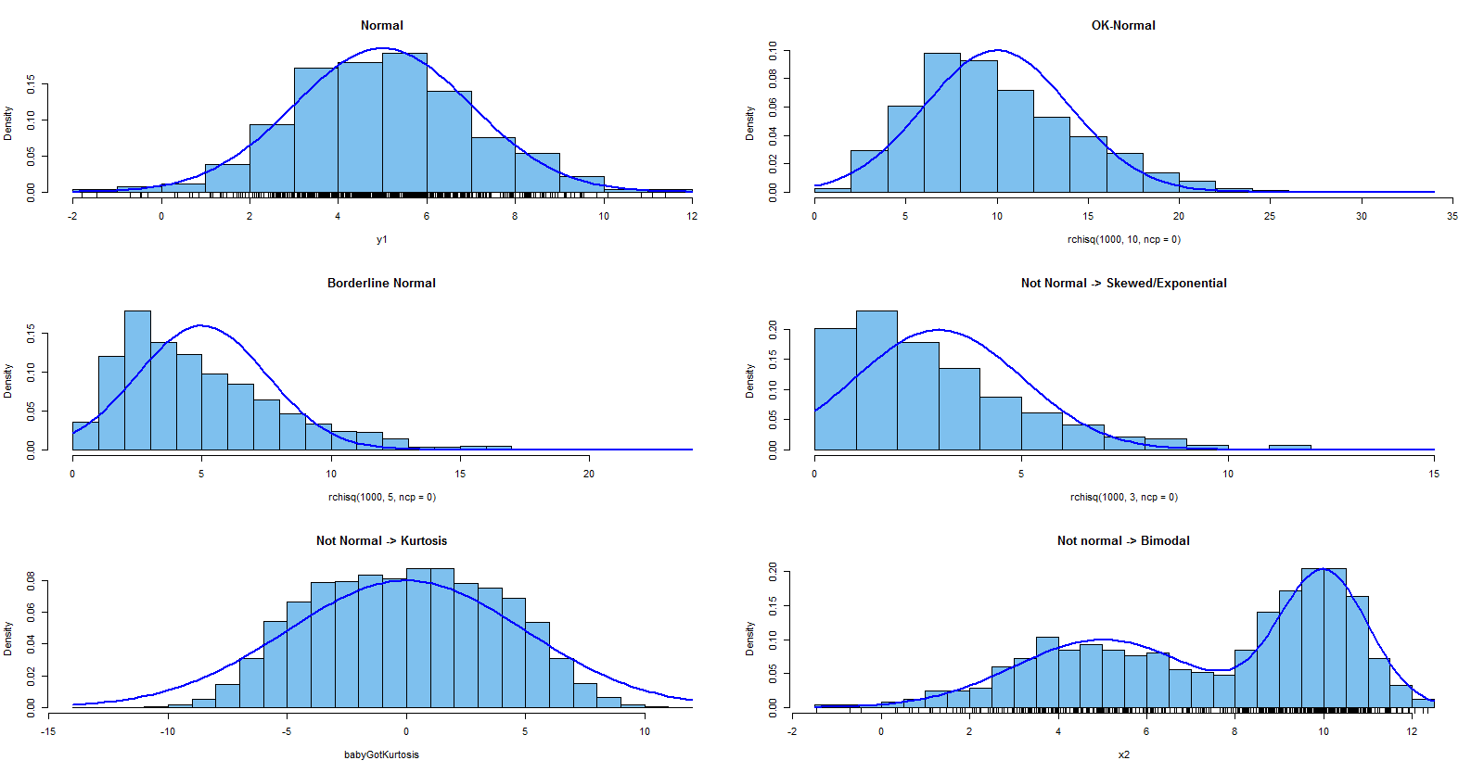
Why normal?
These do really need models for non-normal data (e.g., Poisson/Ex-Gaussian/Mixture) – that’s not bad
Notes:
Deviations:
Show what’s ok, and what’s not ok (e.g., bimodality).
Lessons:
We need statistics because students produce messy data – they are so random that we need to model probability, or uncertainty.
The normal distribution is our friend. Also other distributions are our friends – they allow to summarize all data within just a few statistical parameters. Without the tool of statistical distributions, we would need to model all individual data points, which is most often impossible.

Slide 108
Experimental intervention
time
Pretest
Posttest
Follow-up test
……..
Control intervention
time
Pretest
Posttest
Follow-up test
……..

